Slide 1
Ethical, legal and societal implications of AI in medicine and life sciences
Sonja Aits
“AI for Medicine and Life Science – AI for image and video data”, Lund University
20211025

Slide 2
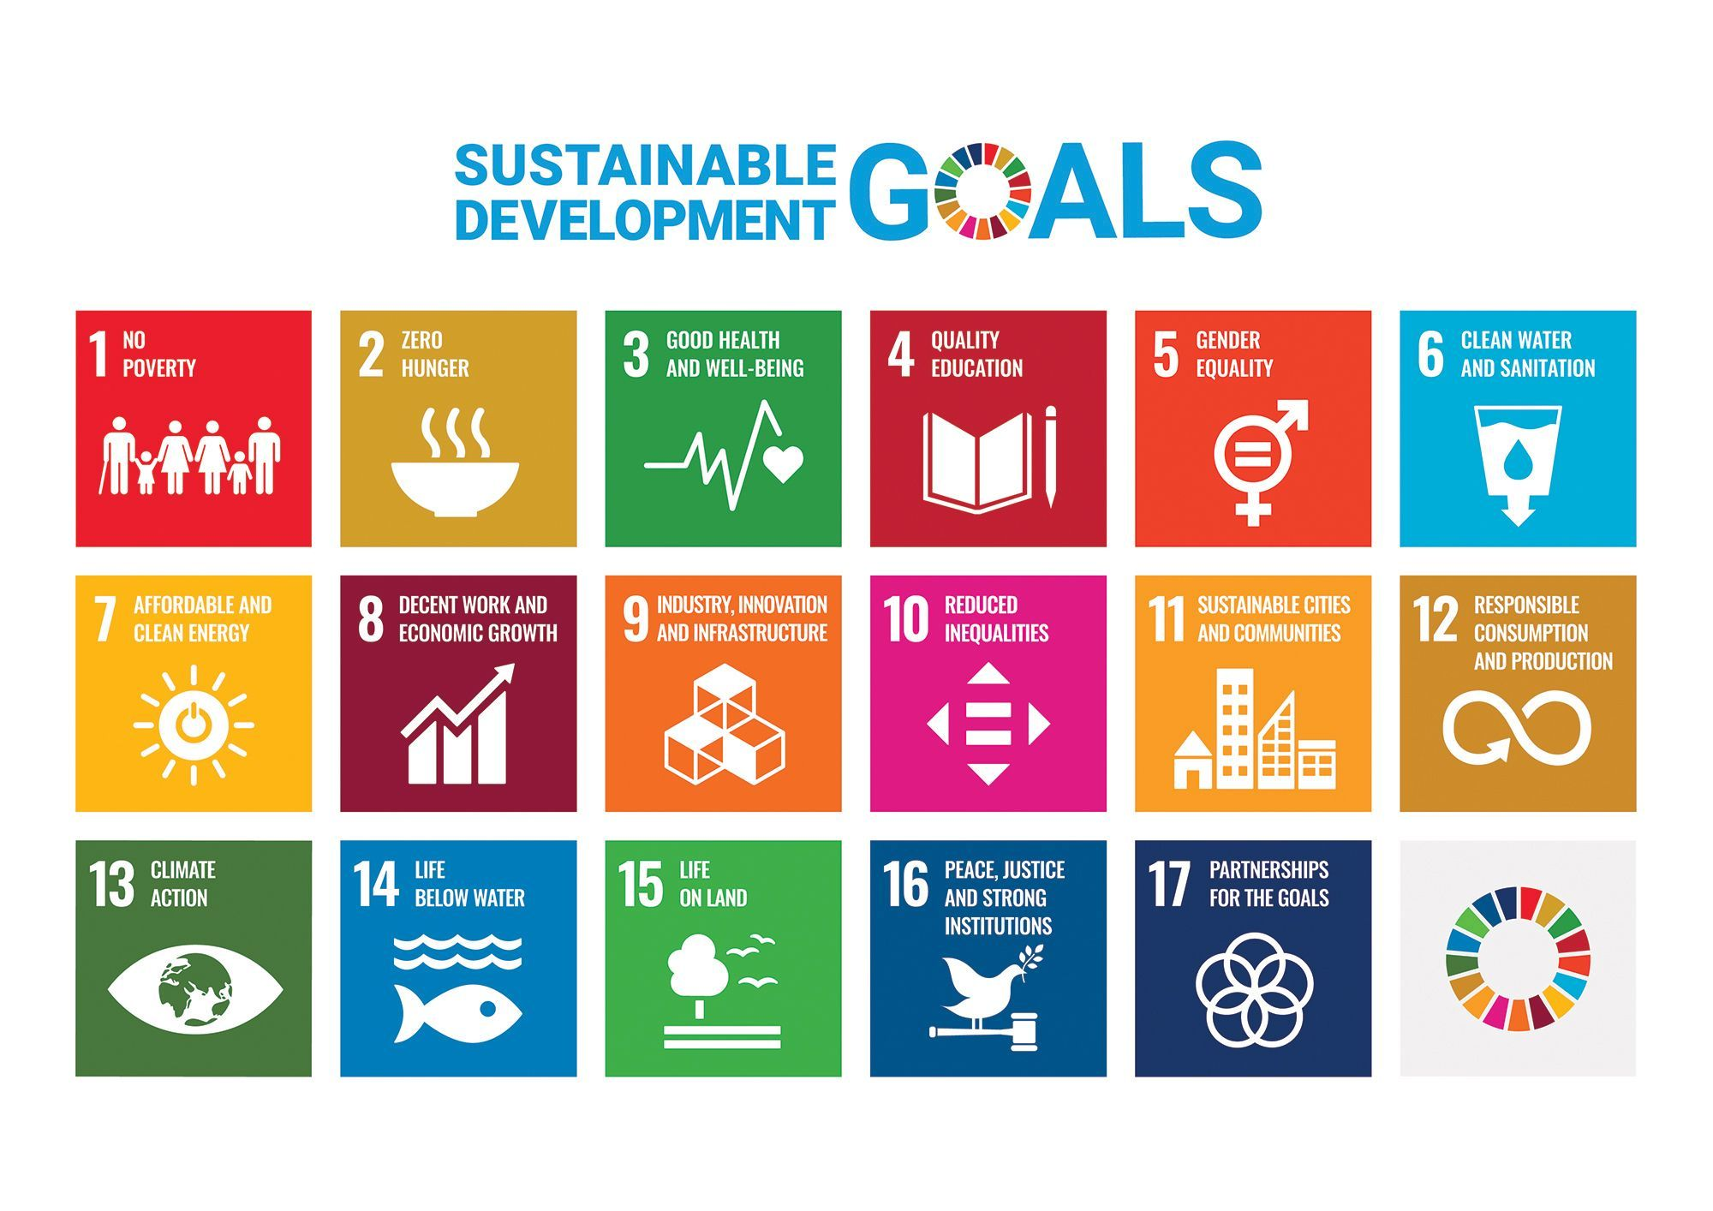
Will AI help achieve a sustainable future?

Slide 3
Is AI good or bad?

Slide 4
Deep learning models are not transparent
Data
Trained model
Predictions/decisions
on new data

Slide 5
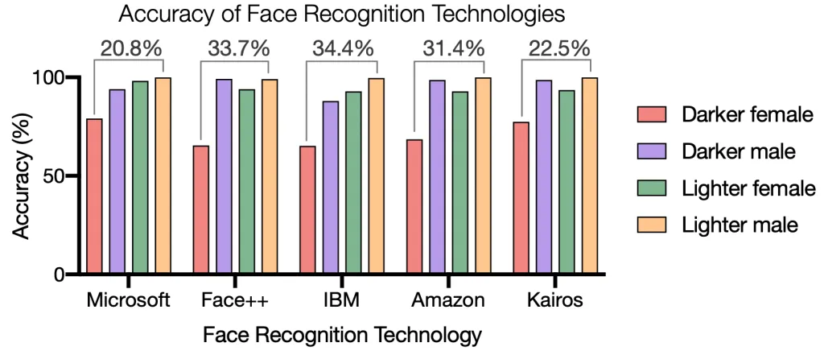
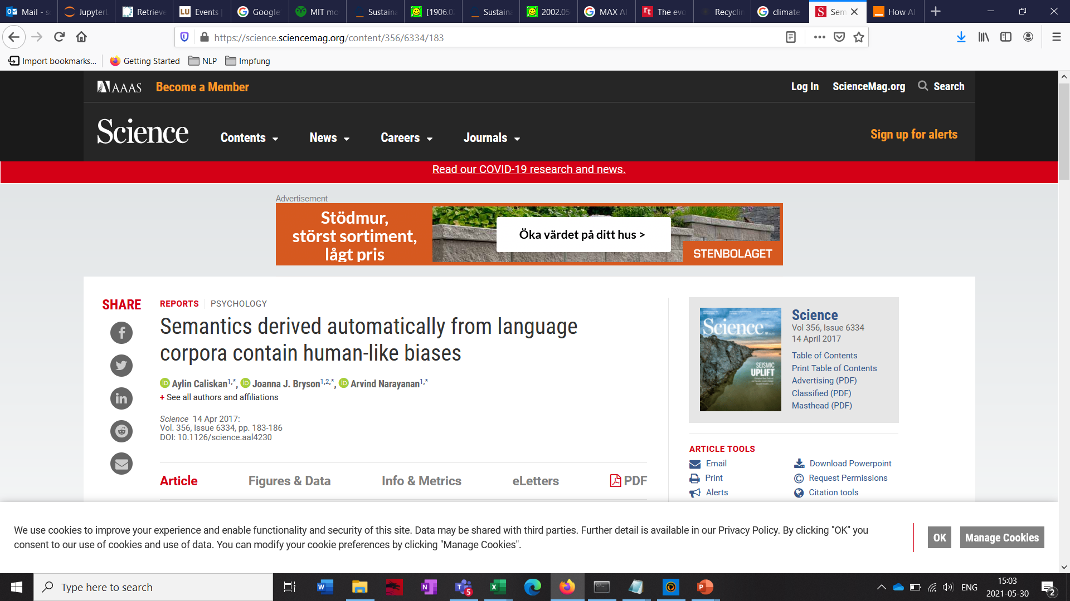
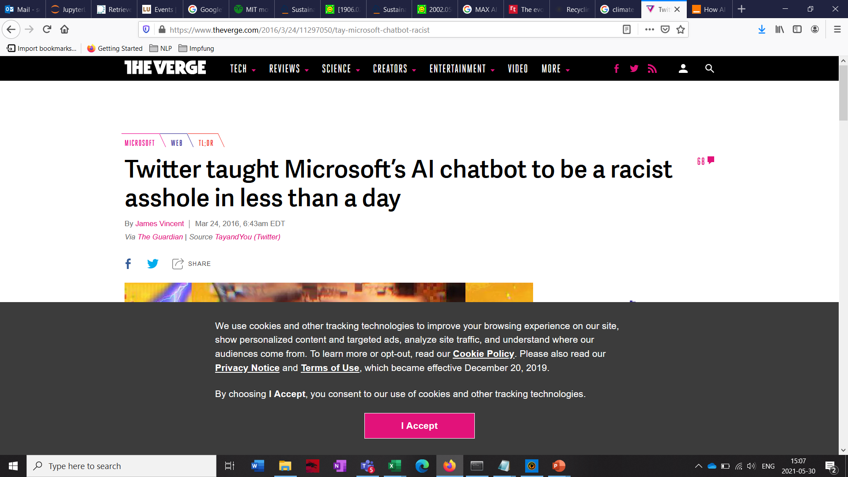
Biased training data makes AI models prejudiced
https://sitn.hms.harvard.edu/flash/2020/racial-discrimination-in-face-recognition-technology/
https://www.theverge.com/2016/3/24/11297050/tay-microsoft-chatbot-racist

Slide 6
What consequences could biased medical AI models have?

Slide 7
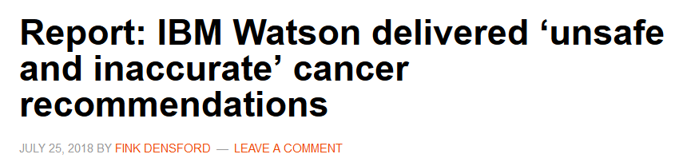


Incorrect predictions of medical AI can be extremely dangerous
“Garbage in – Garbage out”
→Who is liable when things go wrong?

Slide 8
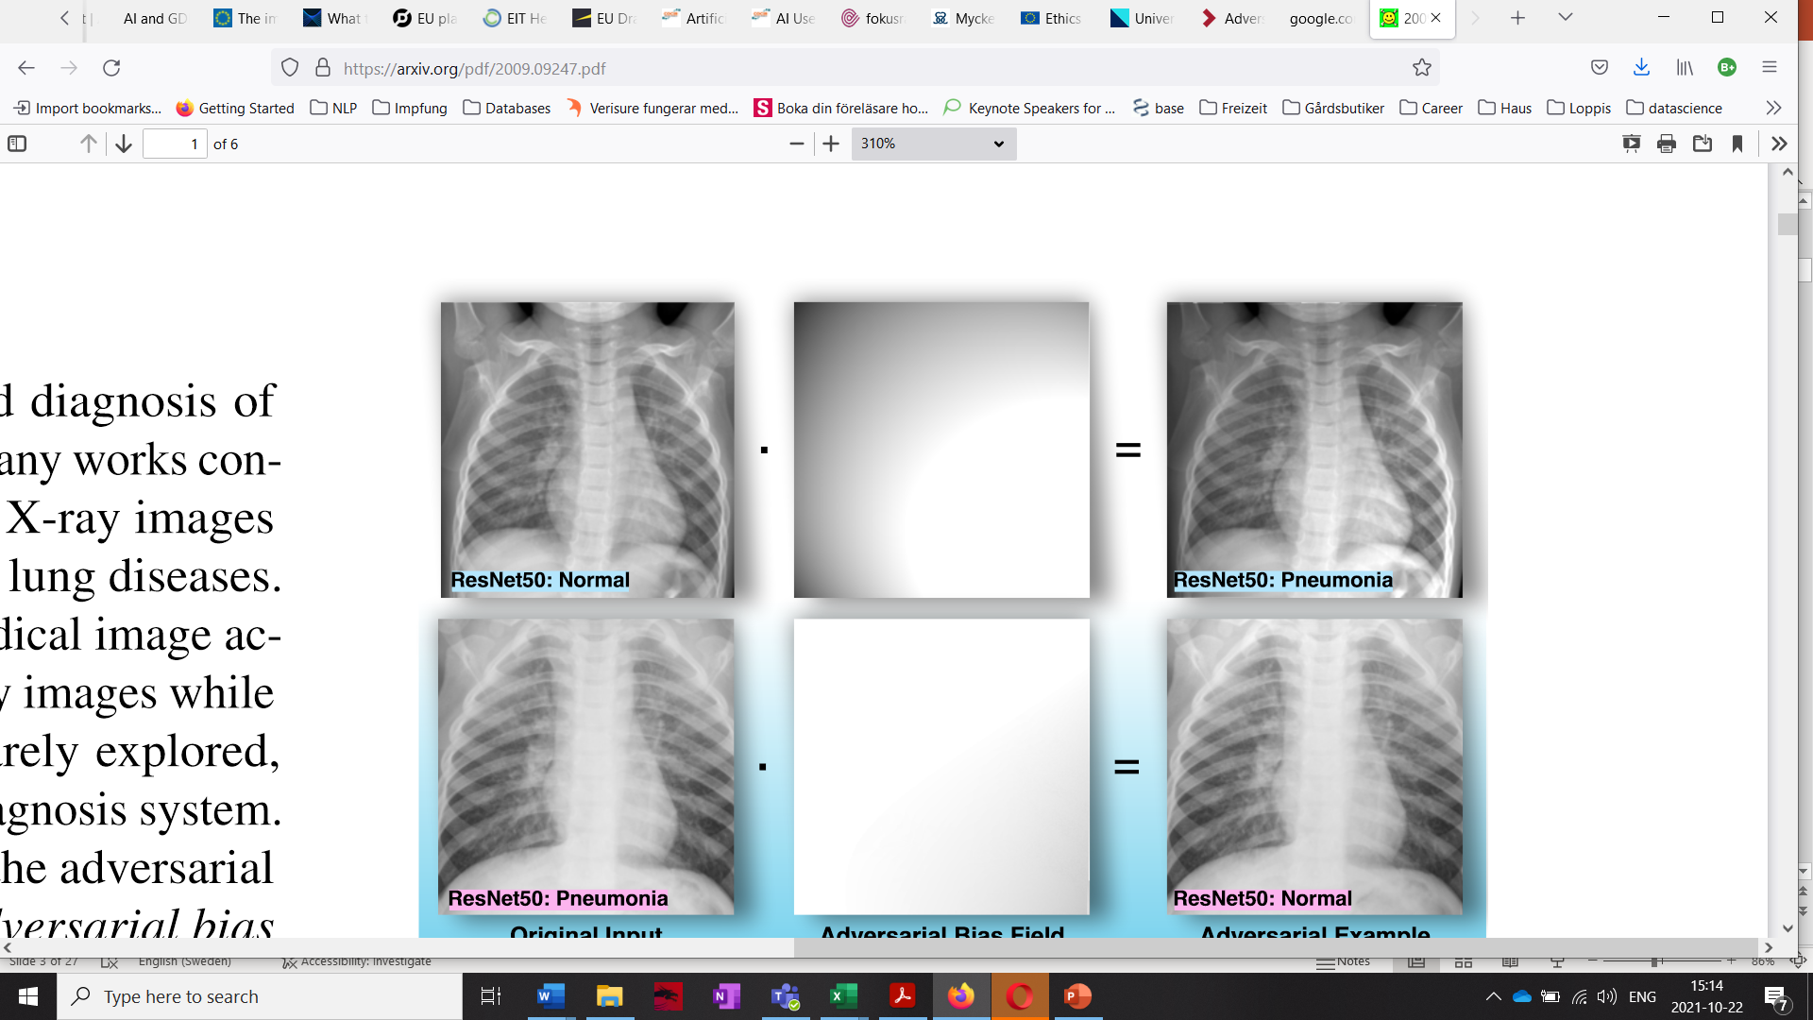
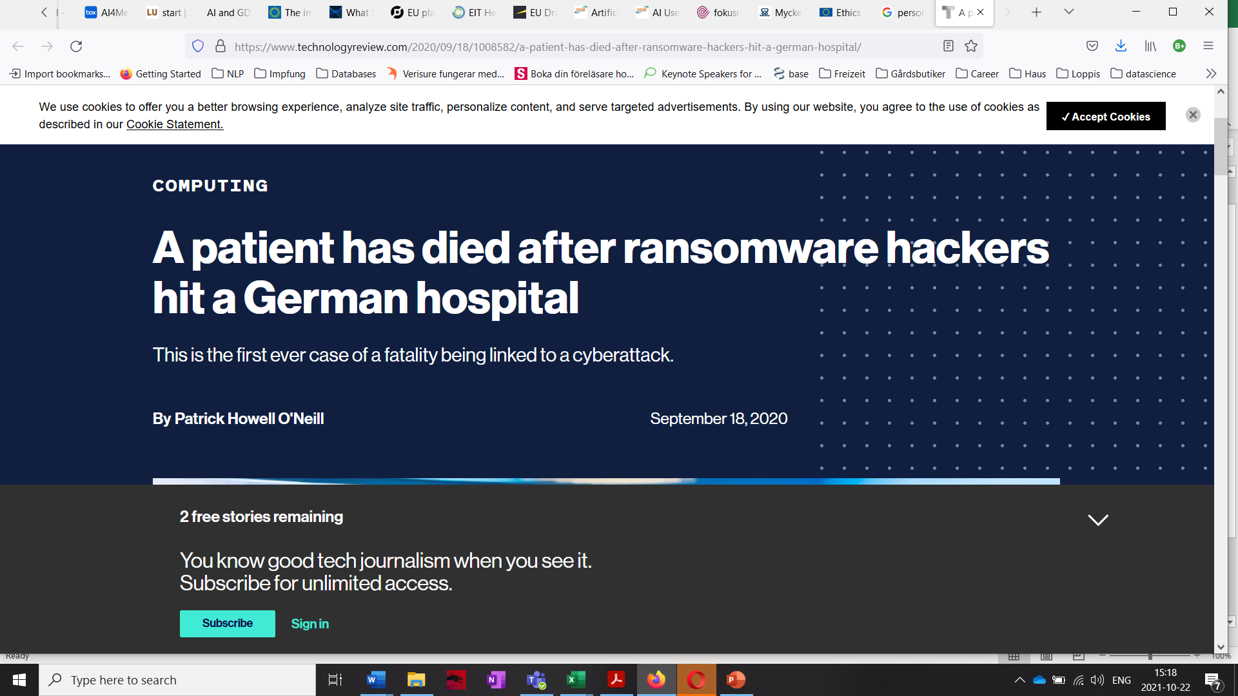
Medical AI systems are vulnerable to malicious attacks
Tian 2020 https://arxiv.org/abs/2009.09247
https://www.technologyreview.com/2020/09/18/1008582/a-patient-has-died-after-ransomware-hackers-hit-a-german-hospital/

Slide 9
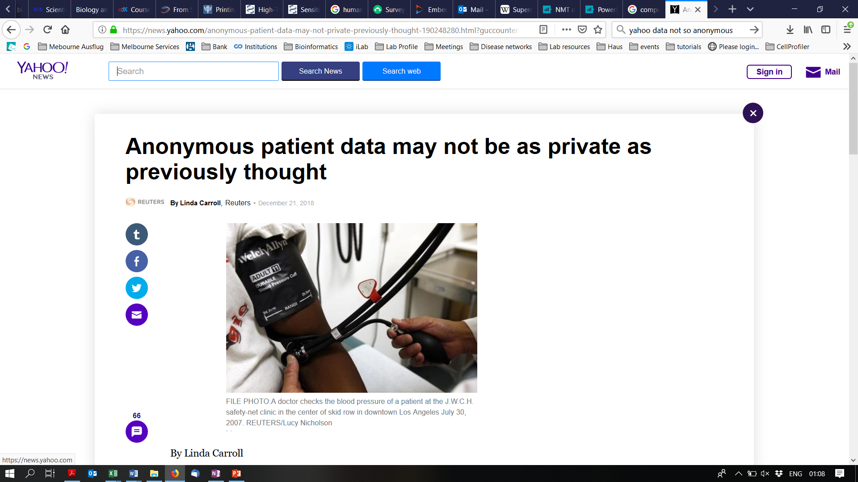
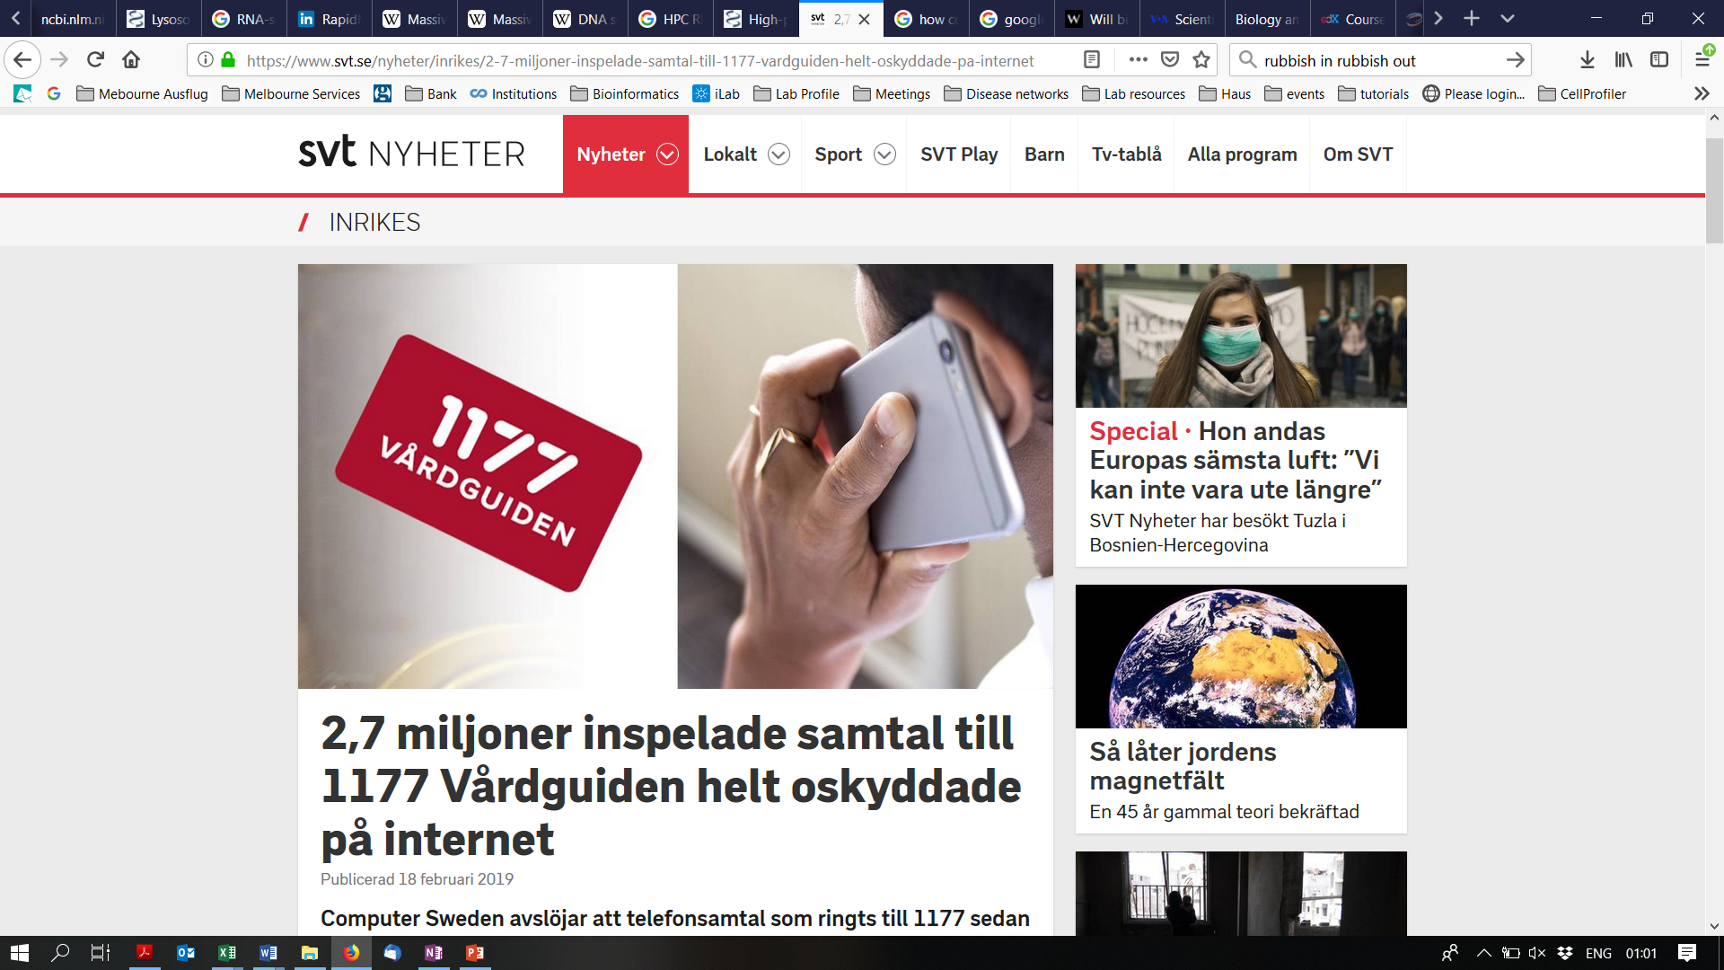
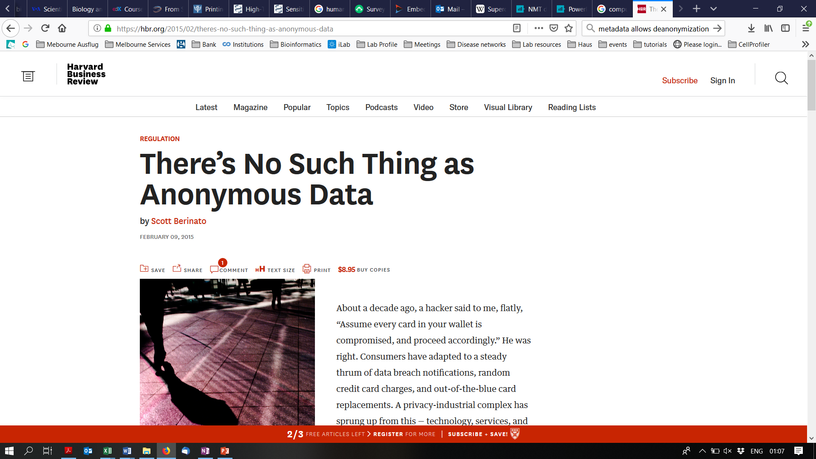
Medical Big Data collection for AI raises privacy concerns

Slide 10
Do you support open research?

Slide 11
What could you do with AI?

Slide 12
What could you do with AI if you were?
the leader of an EU country
the head of the WHO
a primary care doctor in a developing nation
a specialist in the world’s best hospital
the head of Amnesty International

Slide 13
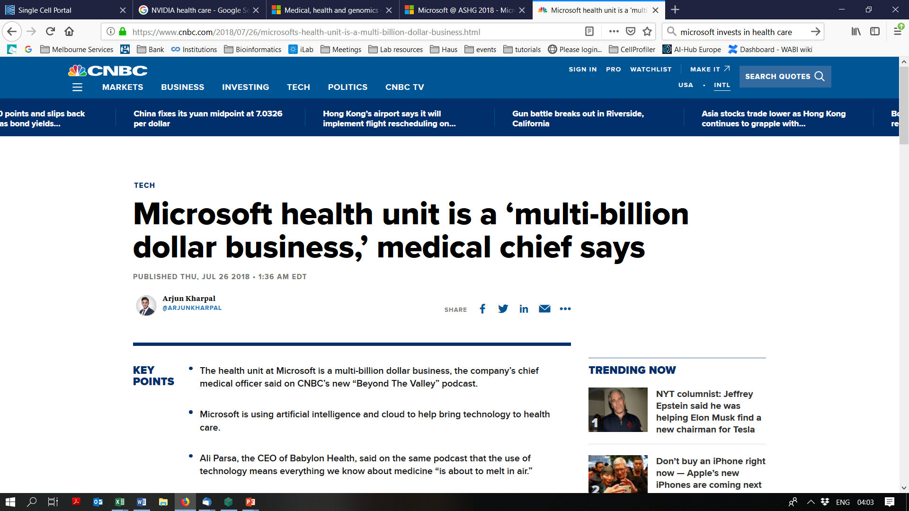
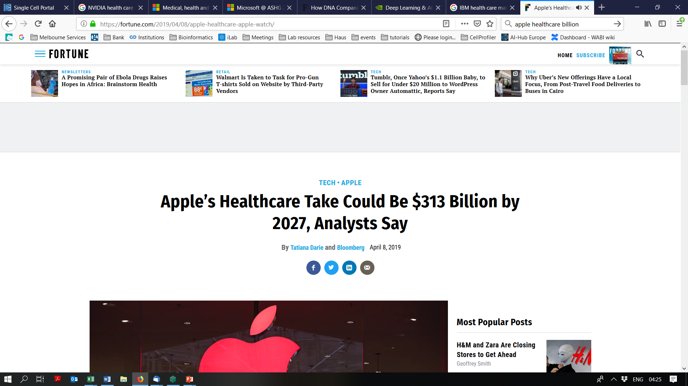
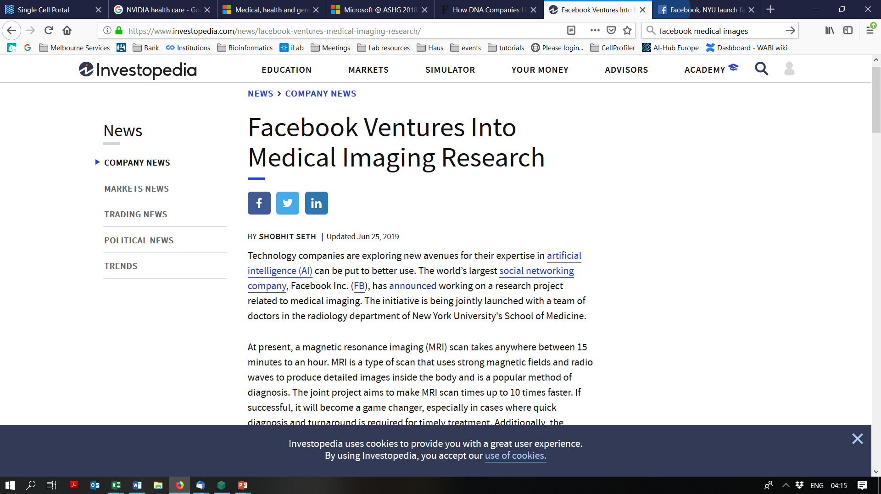
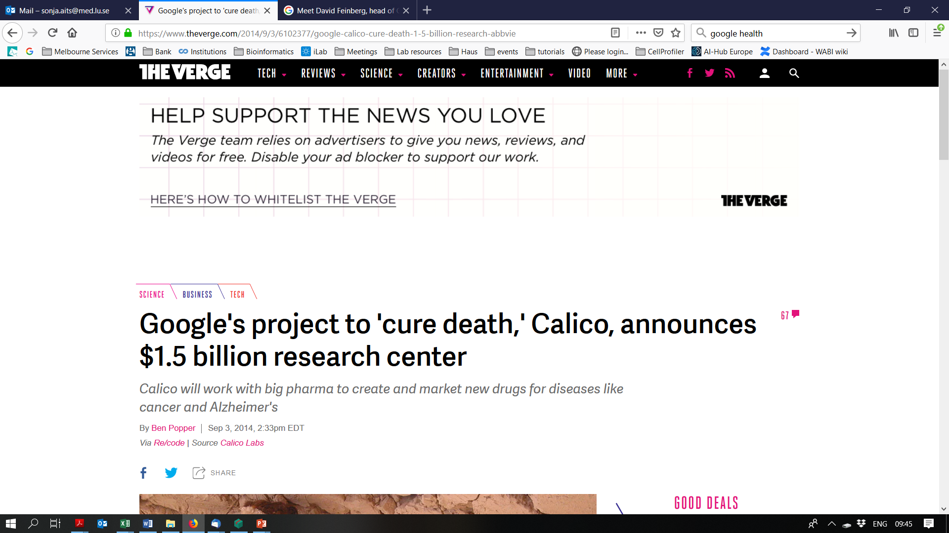
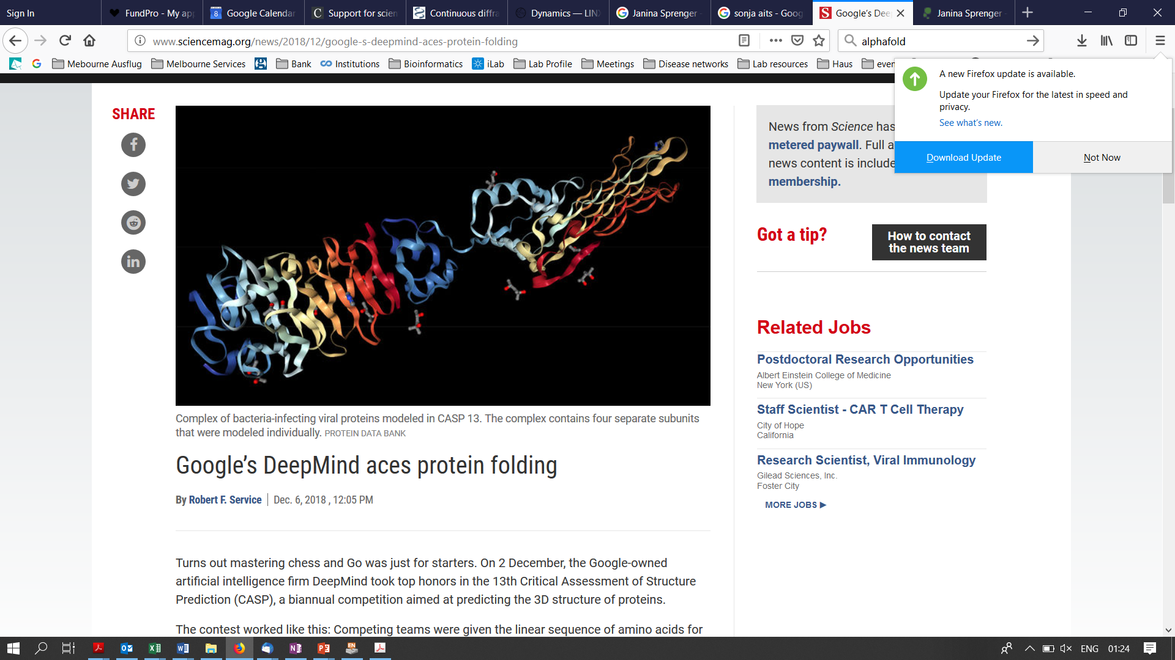
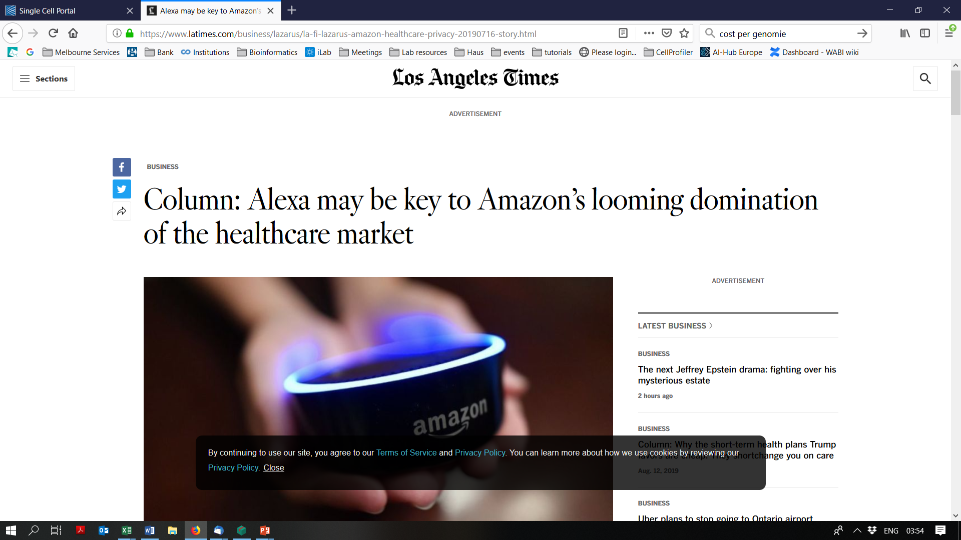

Slide 14
What could you do with AI if you were?
the leader of an EU country
the head of the WHO
a primary care doctor in a developing nation
a specialist in the world’s best hospital
the head of Amnesty International
the leader of a global tech company

Slide 15
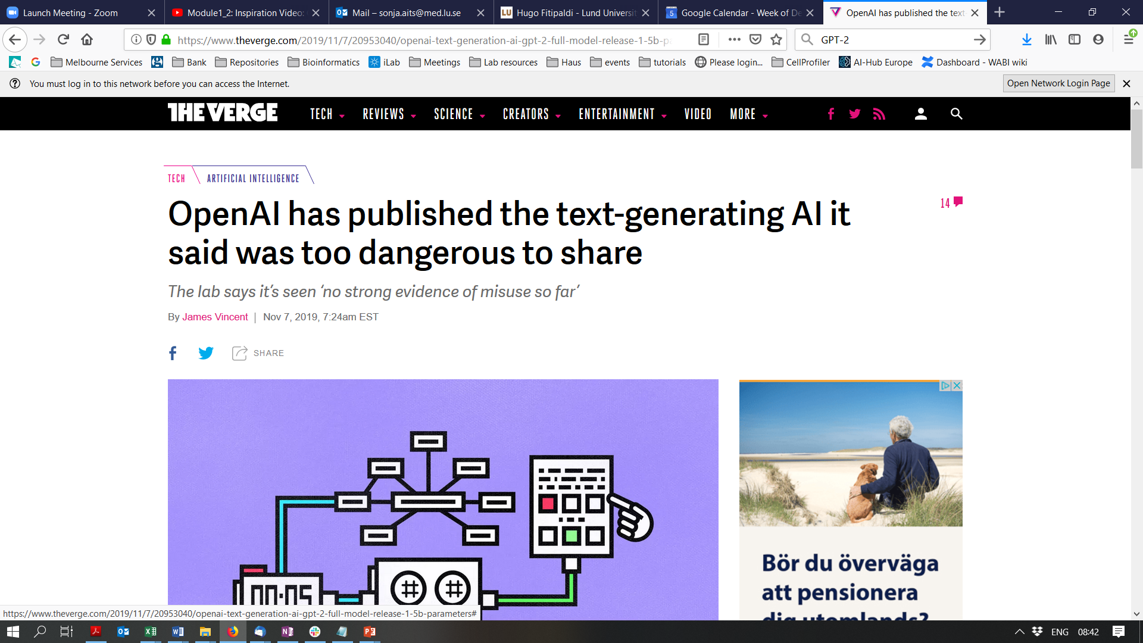
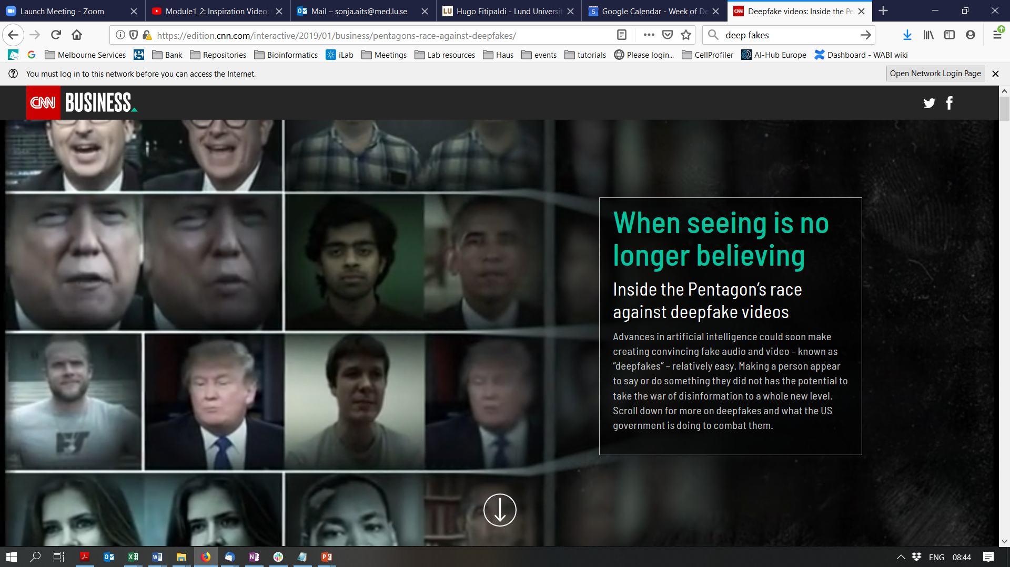

Slide 16
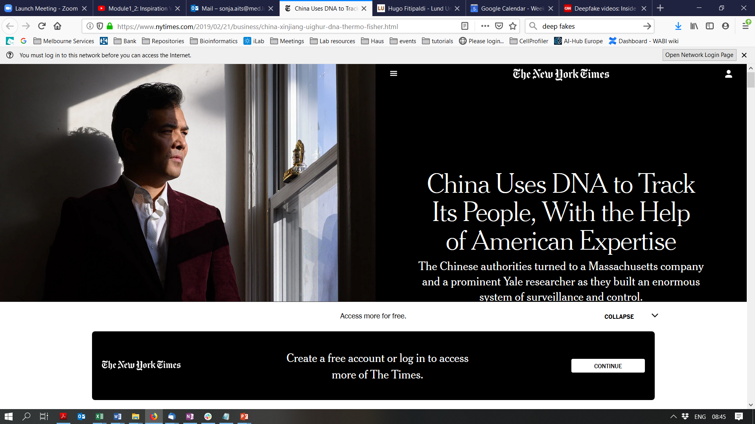

Slide 17
What could you do with AI if you were?
the leader of an EU country
the head of the WHO
a primary care doctor in a developing nation
a specialist in the world’s best hospital
the head of Amnesty International
the leader of a global tech company
a terrorist
a dictator
a white supremacist
a criminal

Slide 18
Could your AI research be re-used in an unethical or illegal way?

Slide 19
Should we have open research and education in the field of AI?

Slide 20
AI is a power-hungry technology
 | Estimated CO₂ emissions (lbs)
Air travel, 1 passenger, NY↔SF | 1 984
Training BERT base | 1 438
Strubell et al. arxiv 2019

Slide 21
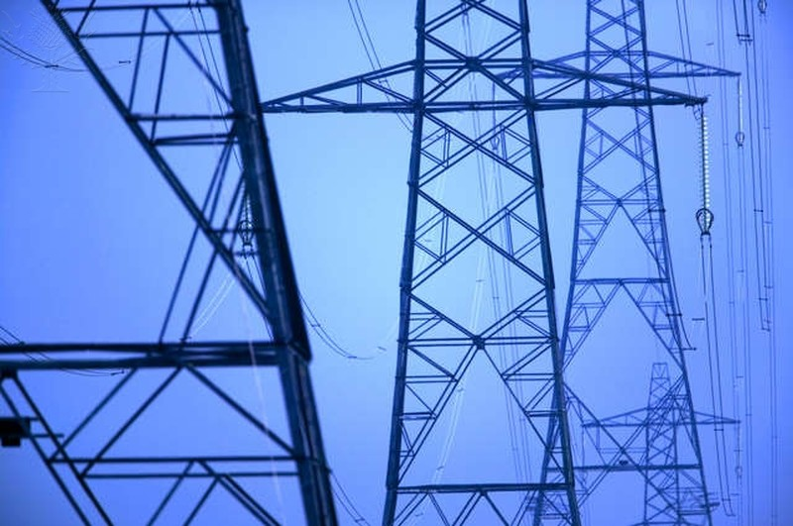

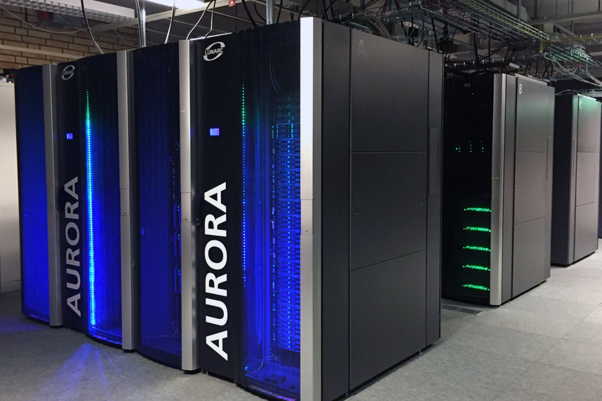
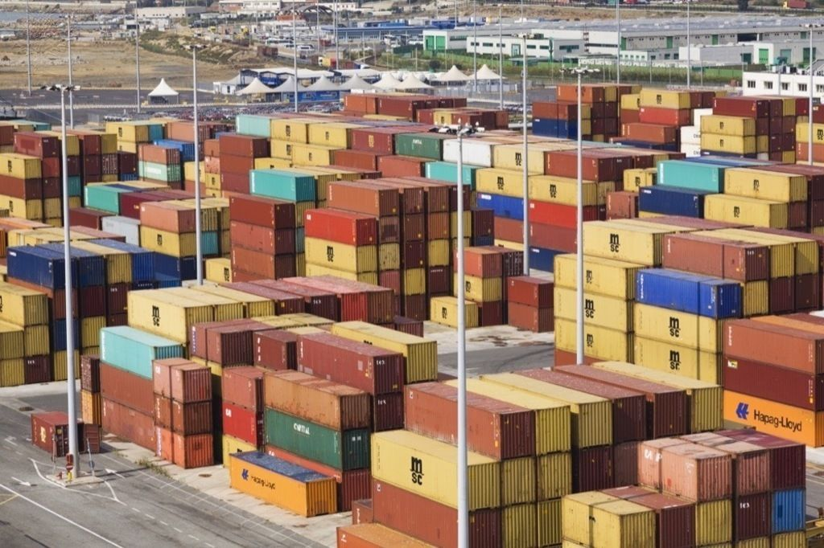
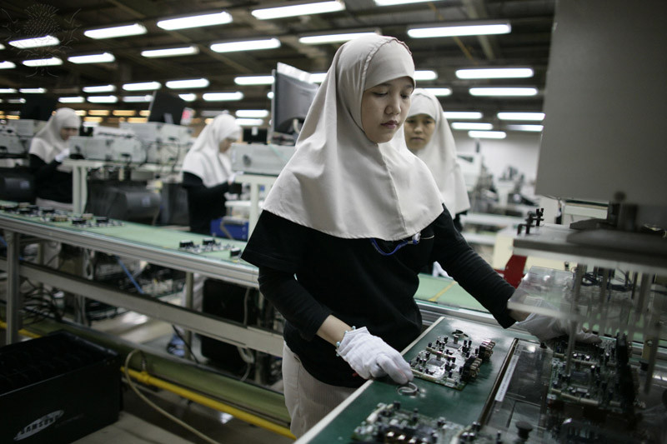
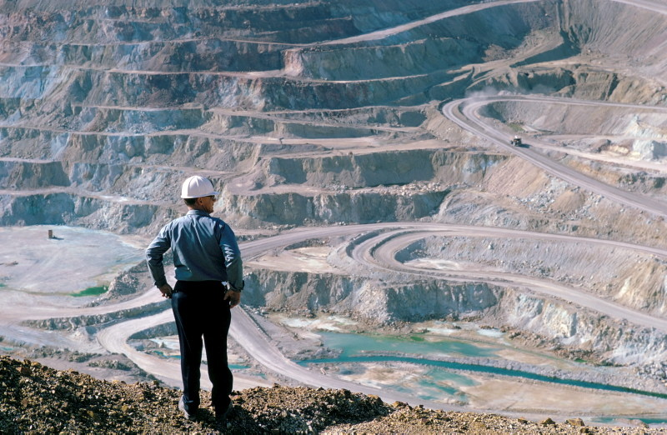
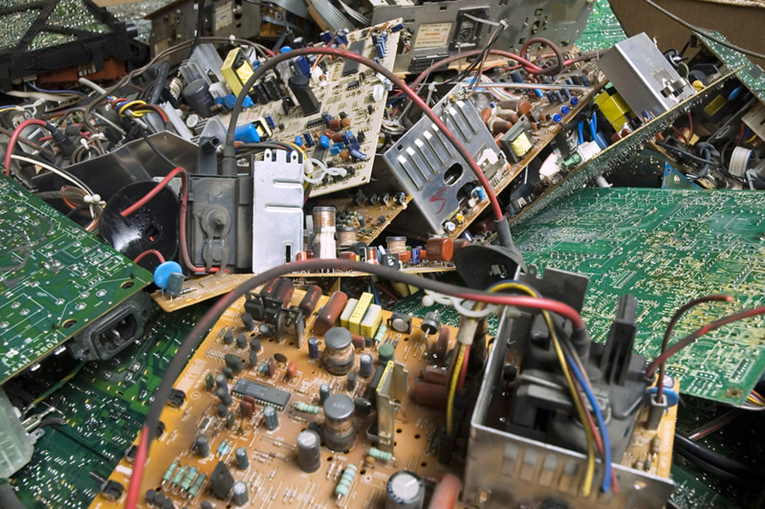
Energy
Researcher
Supercomputer
Transport
Production
Raw materials
Waste and pollution

Slide 22

AI for sustainability
Sustainability of AI

Slide 23
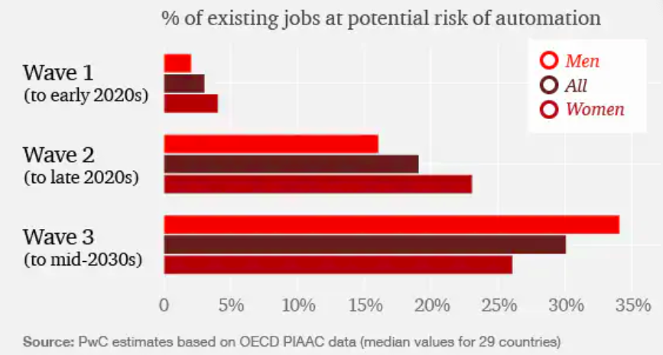
AI will take over many types of jobs

Slide 24
EU Ethics guidelines for trustworthy AI
(1) lawful - respecting all applicable laws and regulations
(2) ethical - respecting ethical principles and values
(3) robust - both from a technical perspective while taking into account its social environment
https://ec.europa.eu/digital-single-market/en/news/ethics-guidelines-trustworthy-ai

Slide 25
7 requirements for ethical AI
Human agency and oversight
Technical Robustness and safety
Privacy and data governance
Transparency
Diversity, non-discrimination and fairness
Societal and environmental well-being
Accountability

Slide 26
Which laws apply?
AI-specific regulation
Data protection regulations
Patient safety regulation
Medical device regulation

Slide 27

EU Regulation on AI (proposal stage)
Unacceptable risk
Social scoring
Harmful manipulative systems
Real-time remote biometric ID systems in public spaces
High risk
Evaluation of creditworthiness
HR tasks
Systems for biometric ID in non-public space
Justice-related systems
Safety-critical systems (e.g. medical)
Minimal/no risk
Spam filters
Inventory systems
Computer games

Slide 28
AI is connected to many ethical, legal and societal challenges
Biased or wrongful decisions + lack of transparency
Large scale collection of private data
Vulnerability to malicious attacks
Unintended use by third parties
Environmental and social issues along the “AI supply chain”
Labour market disruption

Slide 29
How can we all contribute to a constructive
public debate about these matters?

